Slide 1
Relational Model
Engr. Laraib Siddiqui

Slide 2
Relational Data Model
Presented by E. F. Codd in 1970, then of IBM
Based on predicate logic and set theory
First DBMS built on Relational Data Model (RDM) was system R
Another Relational DBMS built during those days was INGRES
The basic structure is relation

Slide 3
Characteristics of a Relational Table
A table is perceived as a two-dimensional structure composed of rows and columns.
Each table row (tuple) represents a single entity occurrence within the entity set.
Each table column represents an attribute, and each column has a distinct name.
Each row/column intersection represents a single data value.
All values in a column must conform to the same data format.
Each column has a specific range of values known as the attribute domain.
The order of the rows and columns is immaterial to the DBMS.
Each table must have an attribute or a combination of attributes that uniquely identifies each row.

Slide 4
Table
STID | STNAME | CLNAME | DOB | SEX
S001 | M. Suhail | MCS | 12/6/84 | M
S002 | M. Shahid | BCS | 3/9/86 | M
S003 | Naila S. | MCS | 7/8/85 | F
S004 | Rubab A. | MBA | 23/4/86 | F
S005 | Ehsan M. | BBA | 22/7/88 | M

Slide 5
Keys
Keys are used to ensure that each row in a table is uniquely identifiable.
It establish relationships among tables and to ensure the integrity of the data.
Key consists of one or more attributes that determine other attributes.

Slide 6
Simple or Composite Key
A key consisting of single attribute is called simple key, e.g., StudentID, ItemNo
A key consisting of more than one attribute is known as composite key, like {Program_Code,Course_Code}

Slide 7
Composite Key Example
COURSE_OFFERING
ProgCode | CourseCode | Total Marks | CrHrs
MCS | DS | 100 | 3
MCS | DBS | 100 | 3
MBA | DBS | 100 | 3
BCS | NW | 100 | 3

Slide 8
Super Key
A super key is a set of one or more attributes which can uniquely identify a row in a table.
StdId | StdName | Address | ClName | CurSem
S1020 | Suhail | Gulshan | MCS | 4
S1038 | Shoaib | Model Town | BCS | 3
S1015 | Tahira | Gulberg | MCS | 2
S1018 | Arif | Korangi | BIT | 4
S1025 | Suhail | FB Area | BCS | 6

Slide 9
Candidate Key
Candidate keys are selected from the set of super keys, the only thing we take care while selecting candidate key is: It should not have any redundant attribute. That’s the reason they are also termed as minimal super key.
StdId | StdName | Address | ClName | CurSem
S1020 | Suhail | Gulshan | MCS | 4
S1038 | Shoaib | Model Town | BCS | 3
S1015 | Tahira | Gulberg | MCS | 2
S1018 | Arif | Korangi | BIT | 4
S1025 | Suhail | FB Area | BCS | 6

Slide 10
Primary Key
A primary key is the main/chosen candidate key from the possible set of candidate keys that is most suitable for entity identification.
It may be a single attribute or a composite key.
None of its attributes can have NULL values.
The other candidate keys called Alternate keys provide another method of accessing records.
Note: A null is no value at all. It does not mean a zero or a space.

Slide 11
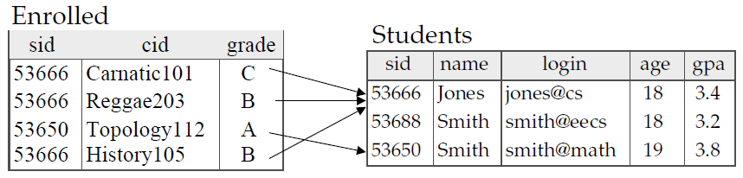
Foreign Key
An attribute of a table B that is primary key in another table A
Consider the given tables
Enrolled (sid, cid, grade)
Students (sid, name, login, age, gpa)

Slide 12
Secondary Key
A secondary key is defined as a key that is used strictly for data retrieval purposes.
Suppose customer data are stored in a CUSTOMER table in which the customer number is the primary key. Do you suppose that most customers will remember their numbers? Data retrieval for a customer can be facilitated when the customer’s last name and phone number are used. In that case, the primary key is the customer number; the secondary key is the combination of the customer’s last name and phone number.
Keep in mind that a secondary key does not necessarily yield a unique outcome.

Slide 13
Mathematical Relations
Consider two sets
A = {x, y} B = {2, 4, 6}
Cartesian product of these sets
A X B= {(x,2), (x,4), (x,6), (y,2), (y,4), (y,6)}
A relation is some subset of this Cartesian product, For example,
R1= {(x,2), (y,2),(x,6),(x,4)}
R2 = {(x,4), (y,6), (y,4)}
The same notion of Cartesian product and relations can be applied to more than two sets
Name = {Ali, Sana, Ahmed, Sara}
Age = {15,16,17,18,…….,25}
Cartesian product of Name & Age
Name X Age= {(Ali,15), (Sana,15), (Ahmed,15), (Sara,15), …., (Ahmed,25), (Sara,25)}

Slide 14
Database Relations
Let A1, A2, A3, …, A_{n} be some attributes and D1, D2, D3,…, D_{n} be their domains
A relation scheme relates certain attributes with their domain in context of a relation
Can be represented as
R = (A1:D1, A2:D2, ……, An:Dn)
STD = (stId:Text, stName: text, stAdres:Text, doB:Date) OR
STD(stId, stName, stAdres, doB)

Slide 15
Database Relations
STD={(S001, Ali, Lahore, 12/12/76), (S002, A. Rehman, RWP, 2/12/77)}
stId | stName | stAdres | doB
S001 | Ali | Lahore | 12/12/76
S002 | A. Rehman | RWP | 2/12/77
According to this scheme we can have a relation (instance of this scheme), like
STD={(stId:S001, stName:Ali, stAdres: Lahore, doB:12/12/76), (stId:S002, stName:A. Rehman, stAdres: RWP, doB:2/12/77)}

Slide 16
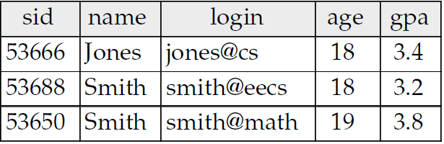
DB and Math Relations
Properties of DB relations are similar to those of Mathematical relations, except the order of columns in Mathematical relation does matter
The number of rows in a relation is its cardinality and the number of columns is its degree.
Cardinality = 3, degree = 5, all rows distinct

Slide 17
Integrity Constraints
Two main types
Entity integrity constraint
Primary key cannot have null value
Referential integrity constraint
Value of Foreign key is either null or matches with a value in its home relation

Slide 18
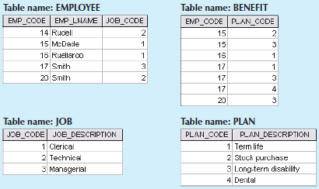
Practice
For each table in the database, identify the primary key and the foreign key(s).
Do the tables exhibit entity and referential integrity?

